Slide 1
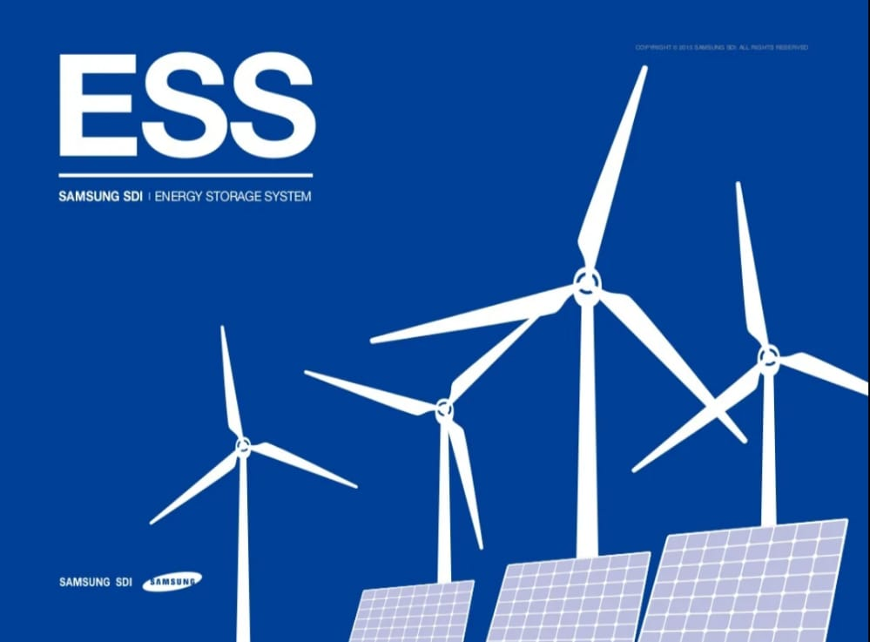

Energy Storage System
Electrical Engineering Department
Name:- Abhishek Kumar
Enrollment No:- 21UEE100
Semsester :- 7th
Section :- B

Slide 2
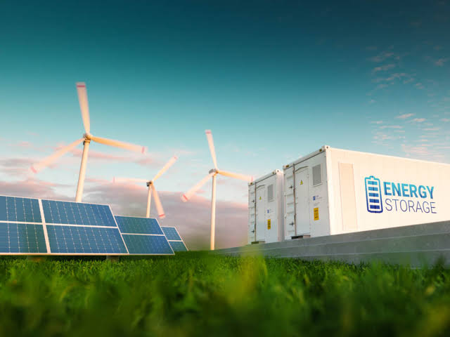
Energy Storage System
Contents
1. What is ESS ?
2. Types of ESS
3. Types of Battery
4. Residential
5. Utility
6. Conclusion
7. Reference

Slide 3

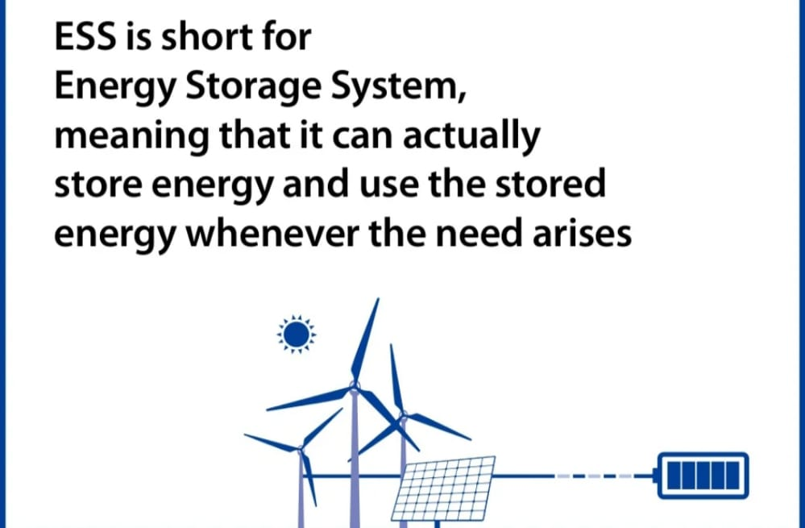
ESS is short for
Energy storage system,
Meaning that it can actually
store energy and use the
stored energy whenever the
need arises…

Slide 4
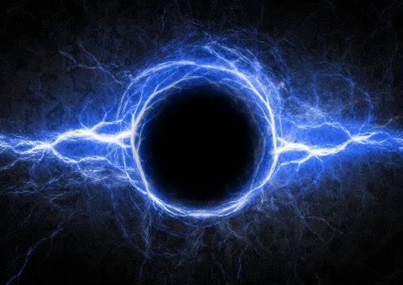
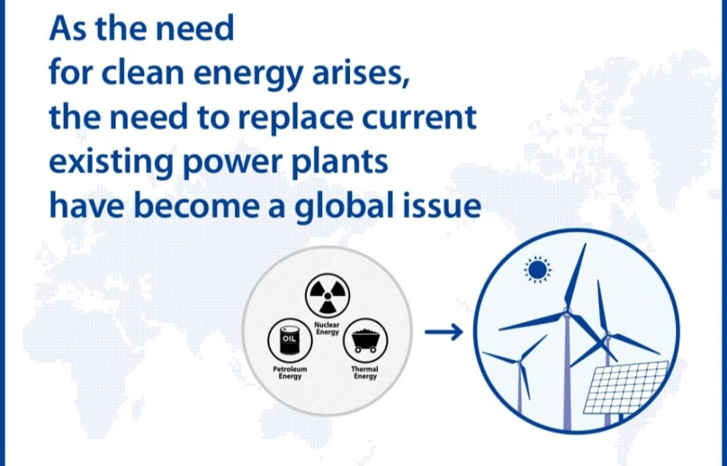
Why ?
As the need
For clean enegy arises,
The need to replace current
existing power plants
have become global issue

Slide 5
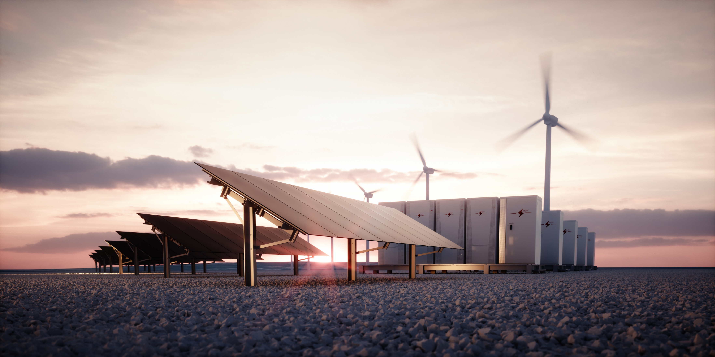
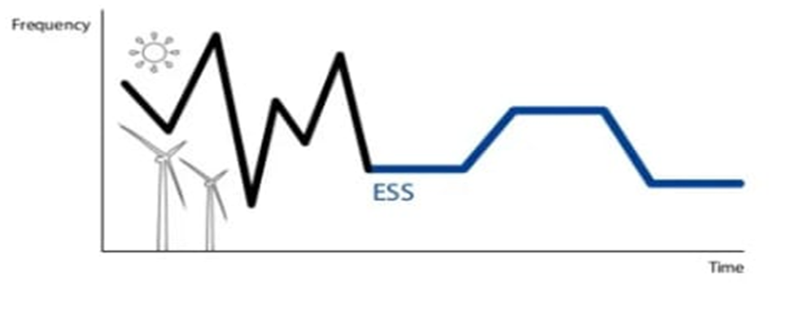
Ess compensates
for intermittency of renewable energy,
such as wind and solar…
To compensate for wind and sunshines’s variability,
Energy storage provides stored electricity to the grid and stable power
output from reneable energy sources.
REDUCES OUTPUT VARIABILITY
IMPROVES POWER QUALITY

Slide 6
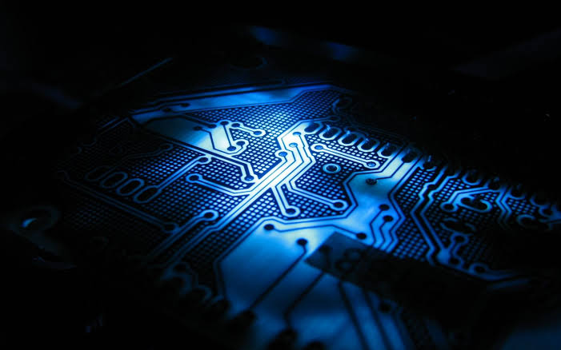
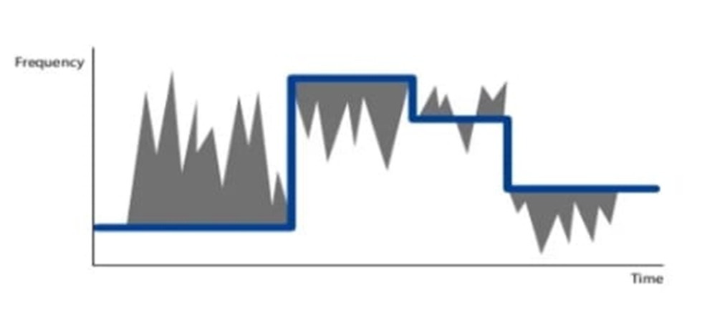
ESS helps grid system operators
maintaine constant frequency
Energy storage based on Lithium-Ion Battery provide realiable and
Fast frequency response without being subject to
fuel prices and with zero emissions.
FAST FREQUENCY REGULATION SERVICE

Slide 7
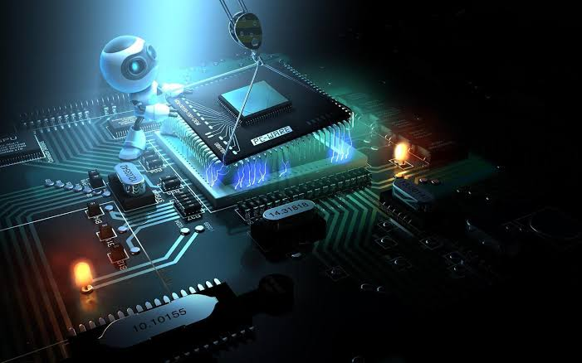
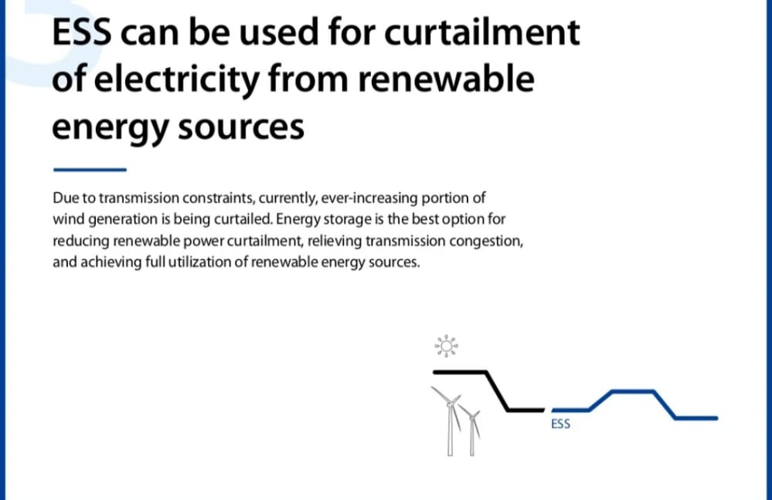
ESS can be used for curtailment
of electricity from renewable
Energy sources
Due to transmission constraints , currently ,ever-increasing portion of
Wind generation is being curtailed.Energy storage is the best option for
reducing renewable power curtailment ,relieving transmission congestion,
And achieving full utilization of renewable energy sources.

Slide 8
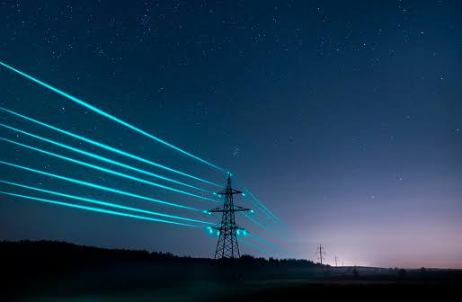
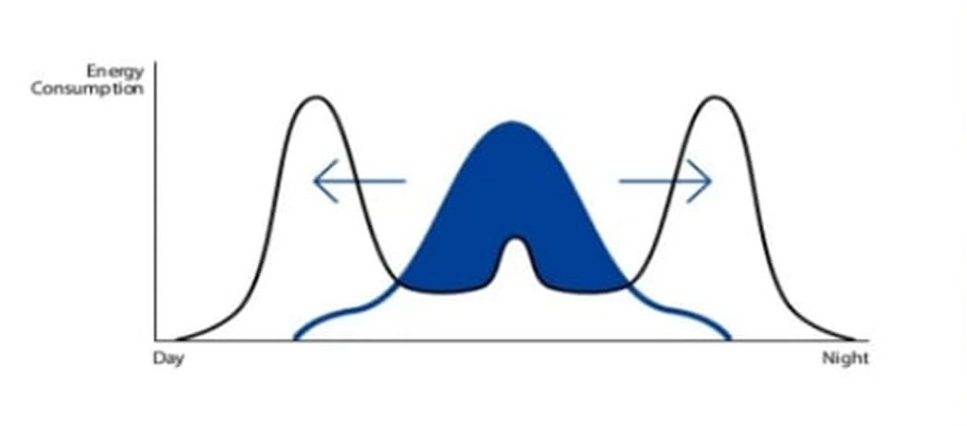
ESS enables
Commericial & residential
Owners to cut energy costs
Electricity stored during off-peak time can be used during on-peak hours so that home/
commercial owners can cut peak demand and electricity cost.
ESS integrated with PV can maximize consumption of energy by
Using electricity stored off-peak.
ENERGY COST SAVING
DEMAND MANAGEMENT
SELF CONSUMPTION OF SOLAR POWER

Slide 9

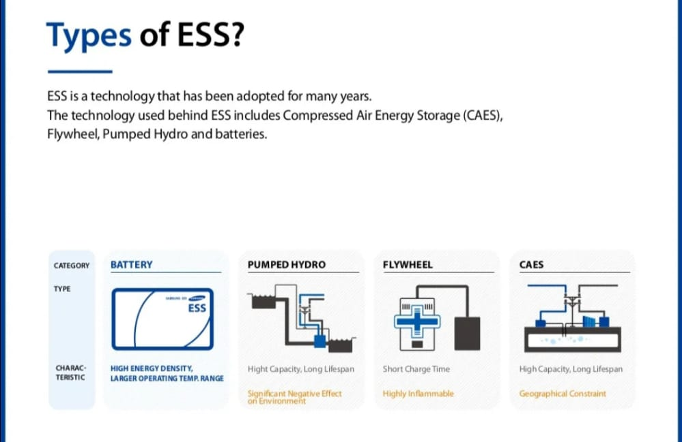
Types of ESS ?
ESS is a technology that has been adopted for many years .
The technology used behind ESS includes Compressed Air Storage(CASES),
Flywheel , Pumped Hydro and batteries.

Slide 10
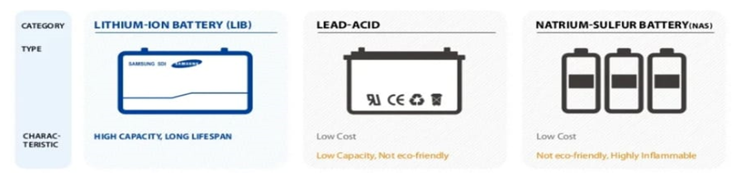
Types of BATTERIES?
Currently battery has becomes mainstream as technologies such as NaS,Lithium-Ion,Lead-acid
and flow batteries have begun to participate in various worldwide projects.
Lithium-Ion Battery which is high in energy density ,
Voltage,discharge rate and lifespan.In addition,
LIB is eco-friendly and has no memory effect ,
Making it optimal for long term use.

Slide 11
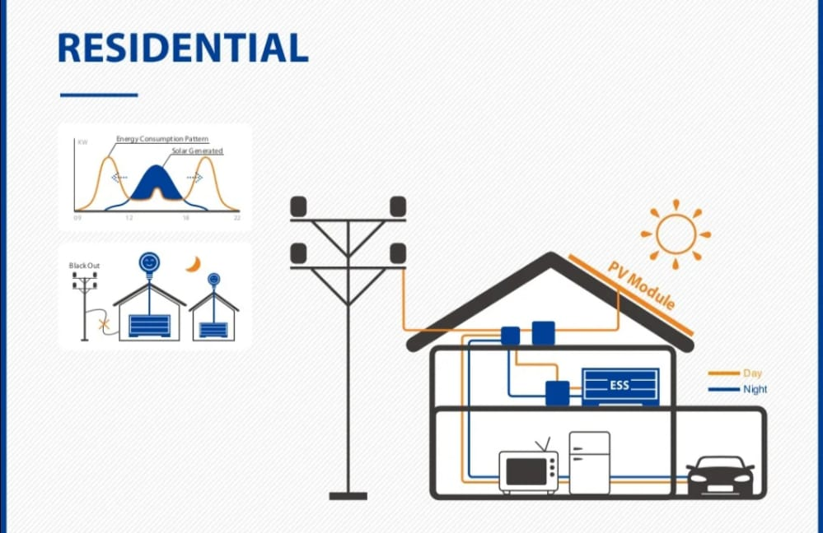
Residential :-

Slide 12
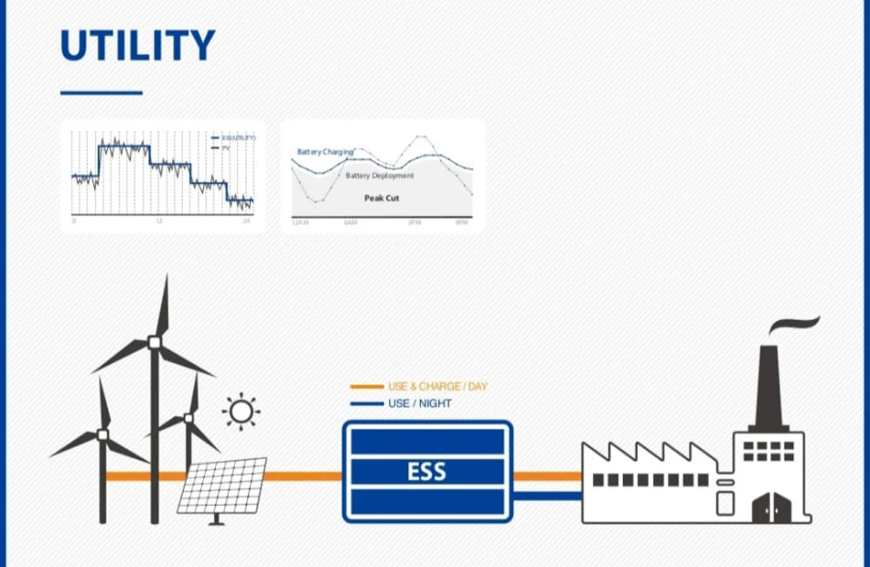
UTILITY :-

Slide 13
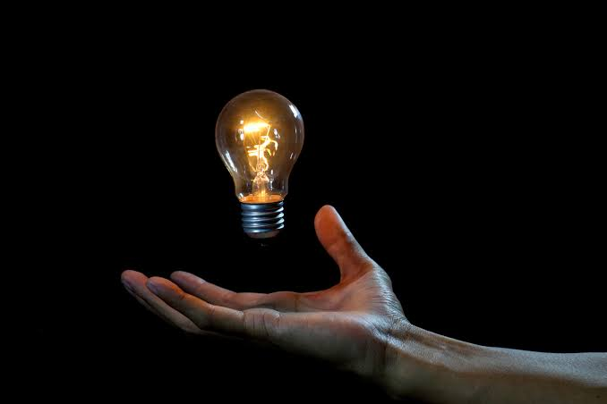
Conclusions:-
Conclusions:-
Reliable and affordable energy storage is a
prerequisite for using renewable energy.
Reliable and affordable energy storage is a
prerequisite for using renewable energy.
Energy storage therefore has a pivotal
Role in the future.
Energy storage therefore has a pivotal
Role in the future.
Energy storage is the most promising technology
currently available to meet the ever
increasing demand for energy .
Energy storage is the most promising technology
currently available to meet the ever
increasing demand for energy .
Page no :-2 Date:- 2/9/22

Slide 14
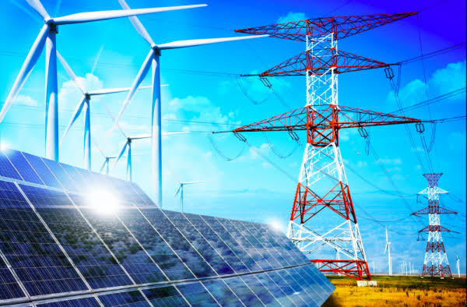
Reference:-
Reference:-
https://en.m.wikipedia.org/wiki/Energy_storage
https://www.ul.com/services/energy-storage-system-testing-and-certification
https://www.infocusinternational.com/energystorage-online
https://en.m.wikipedia.org/wiki/Energy_storage
https://www.ul.com/services/energy-storage-system-testing-and-certification
https://www.infocusinternational.com/energystorage-online

Slide 15
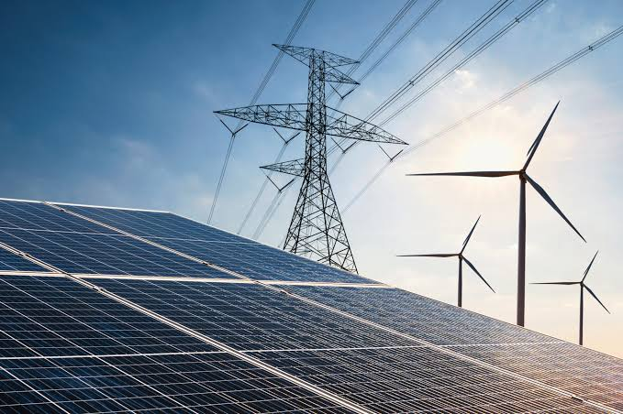
Thank You
Everyone…!

